Slide 1
OpenGLAM: Challenges and Potentials
Dr Stelios Lekakis, Mazomos BV

Slide 2
The Contents
Digital landscape for GLAMs
Development of the OpenGLAM movement: promoting openness of digital collections as the standard for sectoral practice (Europeana)
Copyright vs Open access & Licences

Slide 3
Digital landscape for GLAMs
Since 2000s “a new museum culture” (Sanderhoff 2014: 34): digitisation + openness, peering, sharing and acting globally for doing business (WEB2.0 principles / digital commons)
Openness misunderstood: accessible & reusable (Copyrighted?)
Copyright: ensures that creators, including authors, composers, film makers or other artists, receive recognition, protection and royalties for their work (according to legislation, EU law: +70yrs)

Slide 4
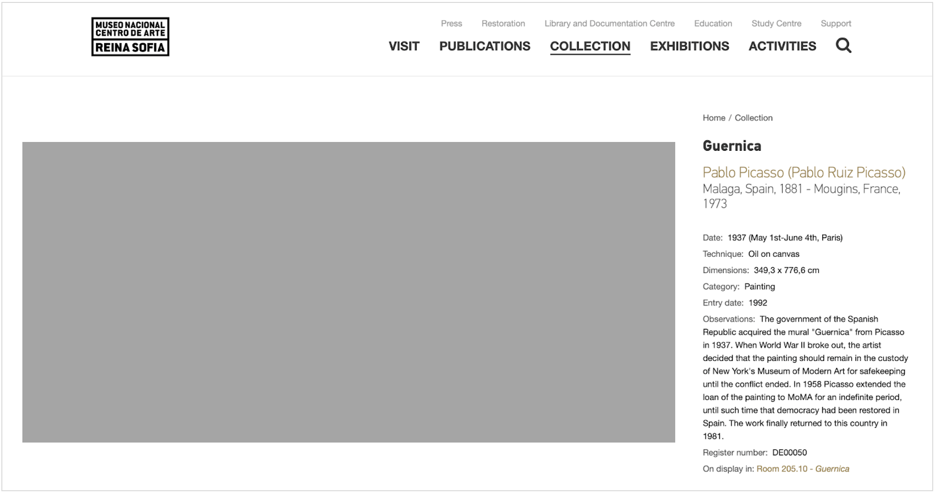
Museo Reina Sofía website displays a digital image of (copyright-protected) Guernica, for viewing only. Here, it has been replaced with a grey box to avoid a rights violation (source: www.museoreinasofia.es)

Slide 5
Digital landscape for GLAMs
Since 2000s “a new museum culture” (Sanderhoff 2014: 34): digitisation + openness, peering, sharing and acting globally for doing business (WEB2.0 principles / digital commons)
Openness misunderstood: accessible & reusable (Copyrighted?)
Copyright: ensures that creators, including authors, composers, film makers or other artists, receive recognition, protection and royalties for their work (according to legislation, EU law: +70yrs)
Open data: ‘anyone is free to use, reuse, and redistribute it - subject only, at most, to the requirement to give credit to the author and/or making any resulting work available under the same terms as the original work (OpenGLAM working group)

Slide 6
Digital landscape for GLAMs
Public Domain: is a pool of shared resources that is made up from all creative works that are not subject to any intellectual property rights. It includes works that have been created before the advent of copyright, works where copyrights have expired, as well as works that have been deliberately placed in the Public Domain by their creators.
Tools to enable: Europeana (EU 2008) / CC licences to help promote open access, knowledge sharing, and collaborative creativity while protecting creators' rights.

Slide 7


Creative Commons Licences
The Creative Commons Zero licence (CC0) & the Public Domain Mark for creative work - used by artists and creators that wish to dedicate their work to the Public Domain thus waiving all of their rights to the work under copyright law. For GLAMs it is often used for waiving rights to metadata related to digitised records and resources.

Slide 8
CC licences (for hesitant institutions/creators)
Each CC license consists of different conditions that determine how a work can be used:
CC BY (Attribution) – Allows others to distribute, remix, adapt, and build upon the work, even for commercial purposes, as long as they give credit to the original creator.
CC BY-SA (Attribution-ShareAlike) – Similar to CC BY, but requires that derivative works be shared under the same license. (Used by Wikipedia)
CC BY-ND (Attribution-NoDerivatives) – Allows redistribution, even commercially, but the work cannot be modified.
CC BY-NC (Attribution-NonCommercial) – Allows remixing and adaptation but not for commercial purposes.
CC BY-NC-SA (Attribution-NonCommercial-ShareAlike) – Non-commercial use only, and derivatives must be shared under the same license.
CC BY-NC-ND (Attribution-NonCommercial-NoDerivatives) – The most restrictive license, allowing sharing with attribution, but no modifications or commercial use.

Slide 9
Access to the digital resources of GLAMs
Restrictions allow GLAMs to retain control over the use of digital images of artworks, thus preventing misuse (e.g. commercial or political appropriations).
When fees apply, GLAMs can also reimburse part of digitisation costs; although in practice, this process involves time-consuming administrative work while sales revenues from copyrighted images are said to remain minor (Sanderhoff, 2014).
On the negative side, restrictions to access undermine GLAMs’ potential to serve as enablers in learning and creative engagement in cultural heritage, push users away from a legitimate source of information (such as official GLAMs websites) and compromise their profile as public institutions.

Slide 10
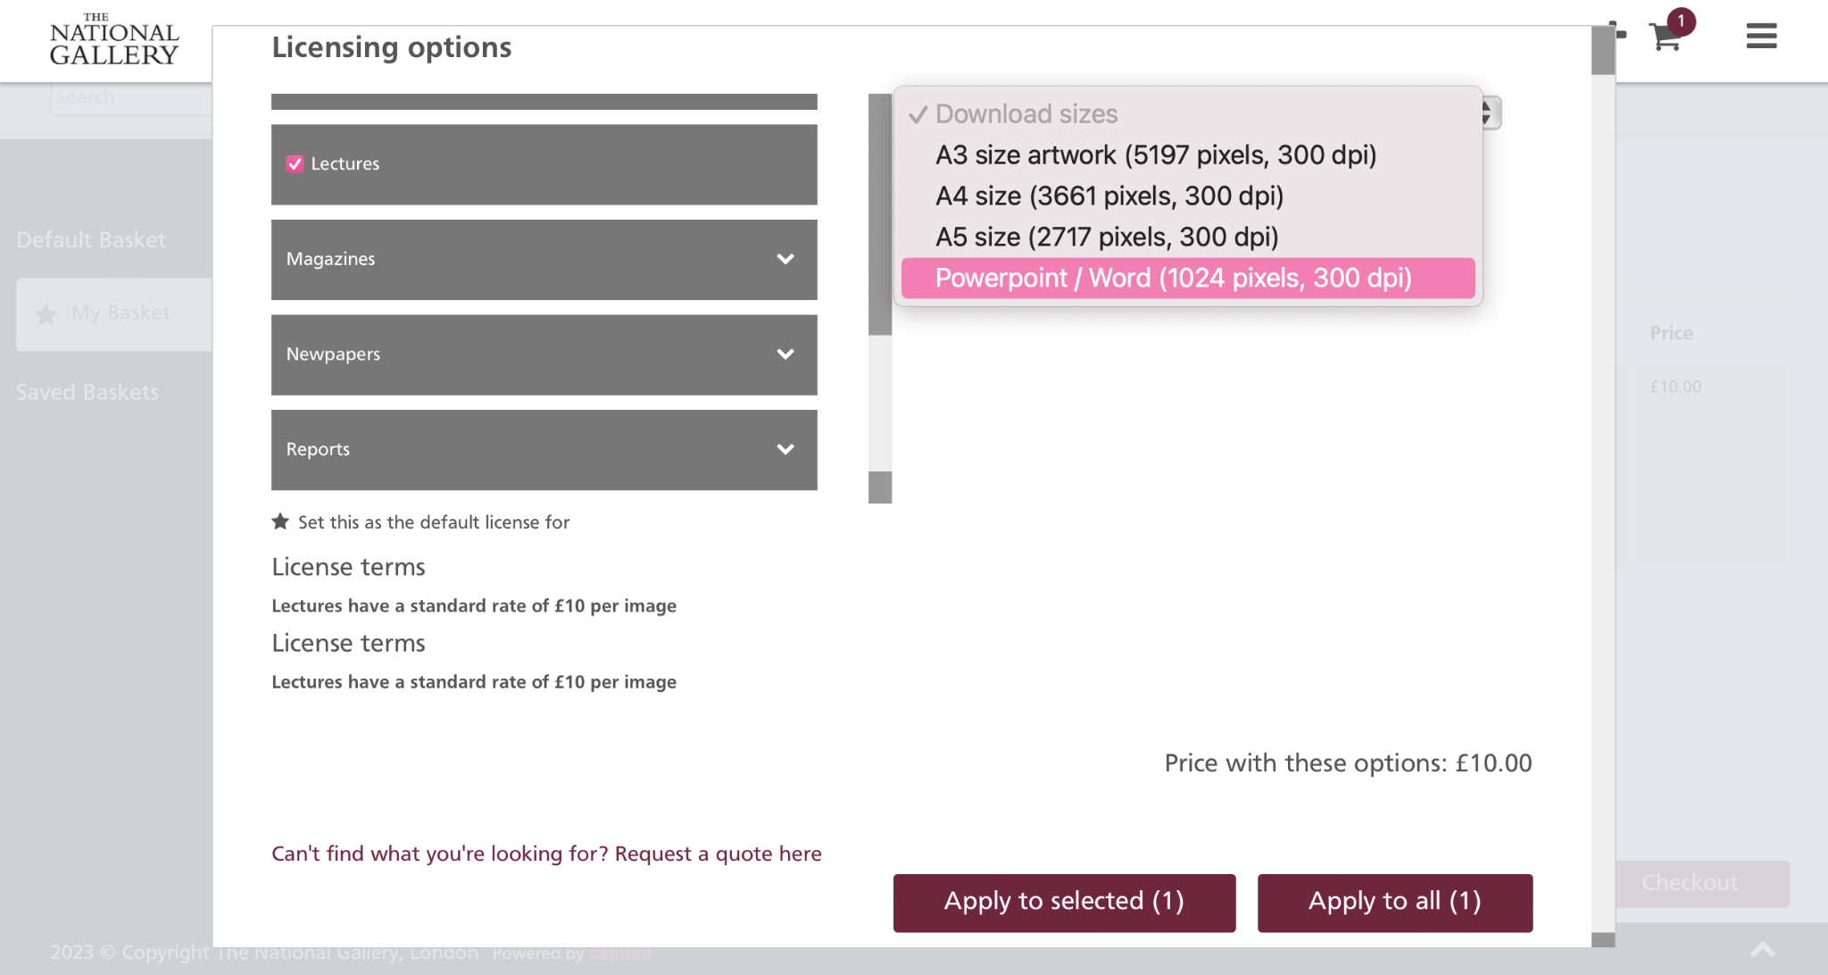
Similar to other UK national museums, the National Gallery charges fees for downloading and reproducing high-resolution images, even of artwork that belongs to the Public Domain (source: https://www.nationalgalleryimages.co.uk).

Slide 11
Good practice?
Declaration on Open Access to Cultural Heritage (OpenGLAM initiative 2013)
Principle 1: Dedicate digital information about the artefacts to the public domain using a proper legal tool, such as the Creative Commons Zero Waiver (CC0).
Principle 2: Do not add new rights to the digital representations of works for which copyright has expired.
Principle 3: Make an explicit statement of your wishes regarding the reuse and repurposing of your data upon its publication.

Slide 12
British Library statement
Please respect the creators – ensure traditional cultural expressions and all ethical concerns in the use of the material are considered, and any information relating to the creator is clear and accurate. Please note, any adaptations made to an image should not be attributed to the original creator and should not be derogatory to the originating cultures or communities.
Please credit the source of the material – providing a link back to the image on the British Library’s website will encourage others to explore and use the collections.
Please share knowledge where possible – please annotate, tag and share derivative works with others as well as the Library wherever possible.
Support the Public Domain – users of public domain works are asked to support the efforts of the Library to care for, preserve, digitise and make public domain works available. This support could include monetary contributions or work in kind, particularly when the work is being used for commercial or other for-profit purposes.
Please preserve all public domain marks and notices attached to the works – this will notify other users that the images are free from copyright restrictions and encourage greater use of the collection.

Slide 13
Good practice?
Declaration on Open Access to Cultural Heritage (OpenGLAM initiative 2013)
Principle 1: Dedicate digital information about the artefacts to the public domain using a proper legal tool, such as the Creative Commons Zero Waiver (CC0).
Principle 2: Do not add new rights to the digital representations of works for which copyright has expired.
Principle 3: Make an explicit statement of your wishes regarding the reuse and repurposing of your data upon its publication.
Principle 4: Publish data in open file formats that are machine readable so that data can be easily extracted by computer programmes.
  such as OAI-PMH (Open Archives Initiative Protocol for Metadata Harvesting) or Axiell API, secures easy access and reuse by those interested.
  Principle 5: Pursue audiences’ engagement in novel ways on the web

Slide 14
Good practice?
  Trust PDA aggregators: Europeana, Flickr Commons and Wikimedia Commons were amongst the first initiatives that served as online libraries and aggregators of cultural metadata from GLAMs across Europe and beyond.
  Today, additional country-specific or thematic open data platforms have also been developed, such as Art UK in Britain, Deutsche Digitale Bibliothek and Coding Da Vinci in Germany, Paris Musées in France, Museums Public Portal in Estonia and many others.
  Aggregators are useful channels for GLAMs disseminating cultural data and promoting content by reaching out to wider audiences (e.g. as compared to the organisation's own website). However, aggregators usually integrate and publish data that is already digitised by GLAMs.

Slide 15
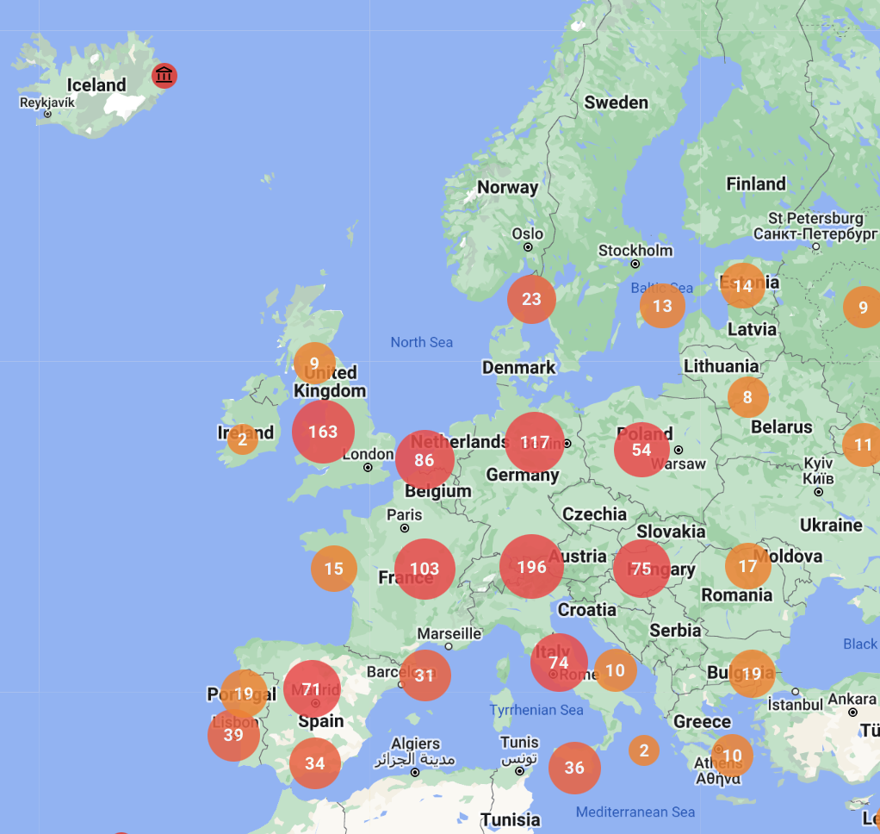
Good practice?
A map of GLAMs in Europe participating in Google Arts & Culture as partner institutions (source: https://artsandculture.google.com/partner?tab=map

Slide 16
Good practice?
The Google Arts project provided the opportunity to many state-subsidised GLAMs with limited resources, capacity and manpower to enter the digital realm and benefit from the tools and a mass-distribution platform that would be impossible to develop independently. The platform features only copyright free and copyright cleared content and the ownership of artworks’ imagery remains with partnering GLAMs. However, digitised materials can be accessed only through Google. This raises some ethical concerns given that the Arts & Culture project allowed Google to conveniently create ‘a walled garden’ by determining access and channel activity through the company’s own tools and applications (Sanderhoff, 2014: 70). Thus, although non-commercial per se, Google Arts assigns excessive power to a private company over how users will engage with public content online.

Slide 17
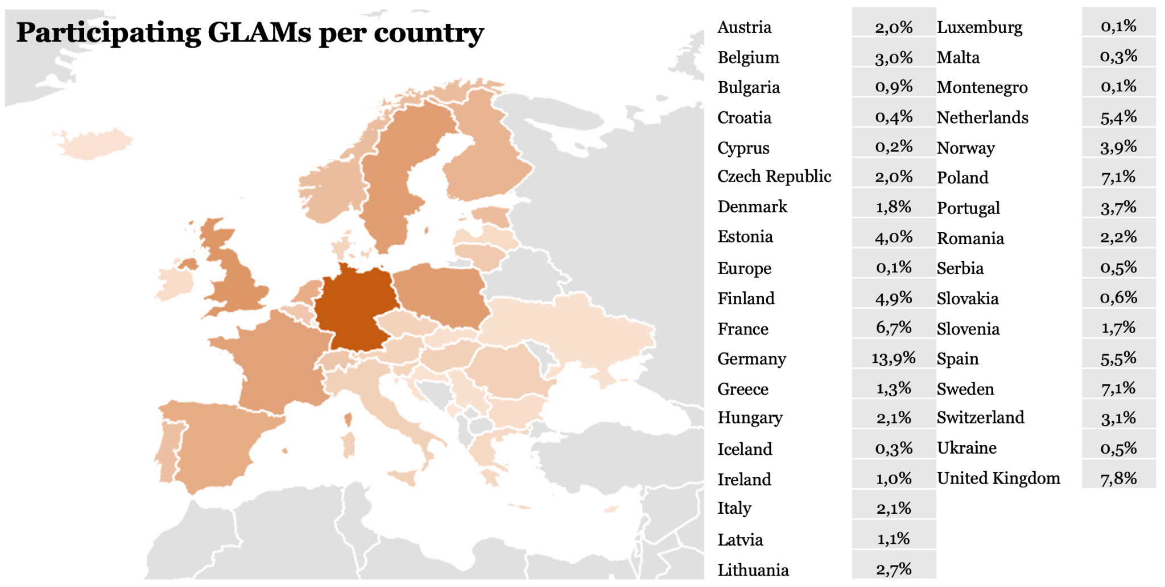
Percentages of participating GLAMs per country in the OpenGLAM survey by McCarthy and Wallace (2018 to present) as of July 2023.

Slide 18
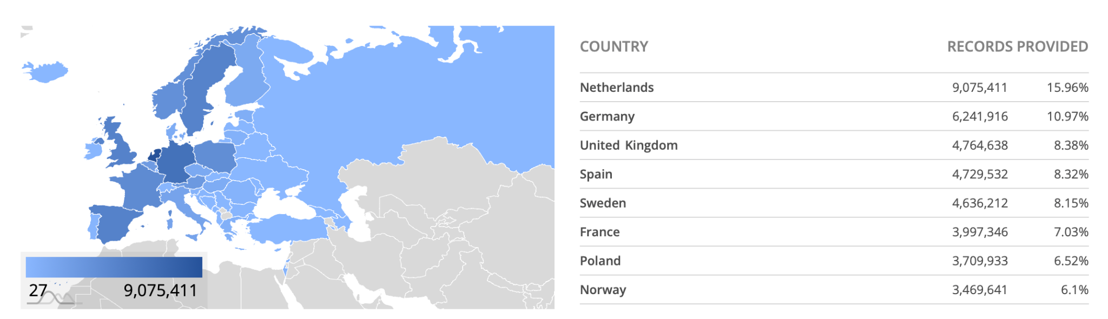
Countries providing digital cultural materials to Europeana ordered by volume of records (source: Europeana)

Slide 19
Implementing open data practice in GLAMs
✅ Choose the Right License
Use CC0 or CC BY for maximum reuse.
Apply Public Domain Mark for out-of-copyright works.
✅ Ensure Data is Structured & Interoperable
Use standard metadata formats (e.g., Dublin Core, IIIF).
Enable Linked Open Data (LOD) for better integration.
✅ Develop Partnerships
Contribute to Europeana, Wikimedia Commons, OpenGLAM initiatives.
Engage with researchers, educators, and creative industries.

Slide 20
Implementing open data practice in GLAMs
✅ Address Ethical & Legal Considerations
Respect privacy, indigenous rights, and sensitive heritage.
Develop policies for ethical data sharing.
✅ Advocate & Train Internally
Educate staff on open data benefits.
Secure leadership support for open access policies.

Slide 21
Resources
Europeana (2022). Europeana DSI-4 Final report, September 2018 - August 2022. Available at https://pro.europeana.eu/files/Europeana_Professional/Projects/Project_list/Europeana_DSI-4/Europeana%20DSI-4_B.5%20Final%20report%202018-2022_M48_PDF%20(Interactive).pdf (last access 27 July 2023).
Kostakis, V. and Giotitsas, C. (2013). Public information as a Commons: the case of ERT and the peer-to-peer prospect. Int. J. Electronic Governance 6,3, 209-213.
Lekakis, S. (2020). A political economy of heritage and the commons: a first sketch focusing on Greece. Cultural Heritage in the Realm of the Commons: Conversations on the, 17.
Lekakis, S., Dragouni, M., (2023). DELIVERABLE 1.7: Copyright and open access for GLAMs in the age of COVID-19. Part of the EU Funded Glammons programme (Grant Agreement No 101060774). Accessible after the end of the programme at glammons.eu.
Markellou, M. (2023). Cultural Heritage Accessibility in the Digital Era and the Greek Legal Framework. International Journal for the Semiotics of Law-Revue internationale de Sémiotique juridique, 1-25.
McCarthy, D. and Wallace, A. (2018 to present). Survey of GLAM open access policy and practice (database). Available at https://docs.google.com/spreadsheets/d/1WPS-KJptUJ-o8SXtg00llcxq0IKJu8eO6Ege_GrLaNc/edit#gid=1216556120 (last access 21 July 2023).
Open Society Institute (2002). Declaration: Budapest Open Access Initiative. Available at https://www.budapestopenaccessinitiative.org/read/ (last access 20 July 2023).
OpenGLAM initative 2025. Accessible at openglam.org.
Sanderhoff, M. (2014). ‘This belongs to you: On openness and sharing at Statens Museum for Kunst’. In Sanderhoff, M., (Ed.), Sharing is caring: Openness and sharing in the cultural sector, Statens Museum for Kunst, Copenhagen, pp. 20-131.

